Slide 1
Introduction to Parallel Computing
DESIGN OF NEW MATERIALS USING SUPERCOMPUTERS

Slide 2
LEARNING GOALS
What is the difference between serial and parallel computing? Why do we need parallel computing?
introduction to programing
How supercomputers apply parallel computing
Message Passing Interface to apply parallel computing
Think of some examples where you benefit/can benefit from parallelization !!

Slide 3
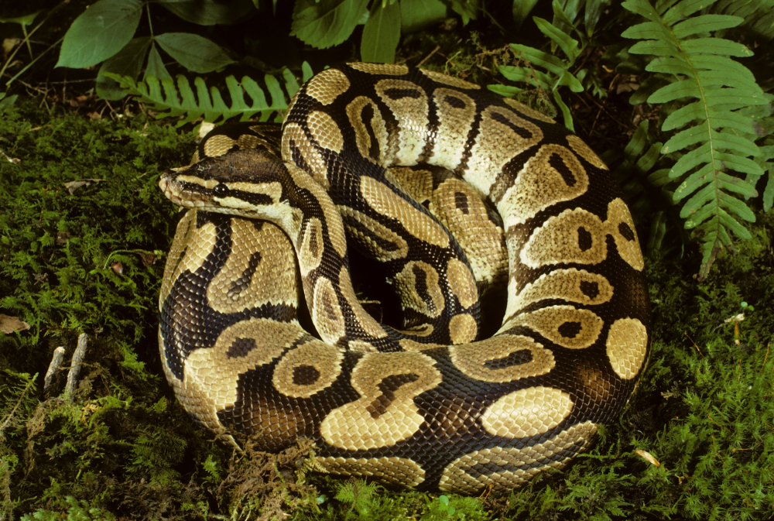
SERIAL PROGRAMING
QUIZ: Which is a programing language?
A) Rattlesnake
B) Garden snake
C) King Cobra
D) Python
Serial computing example next
Notes:
Some historical figures

Slide 4
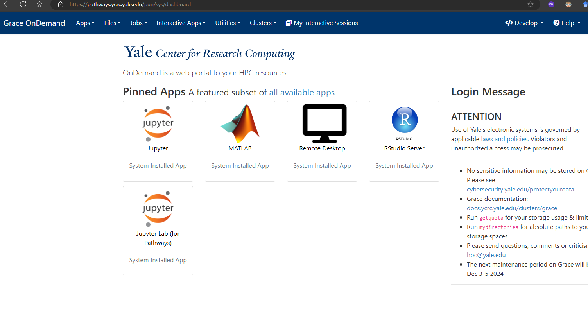

Slide 5
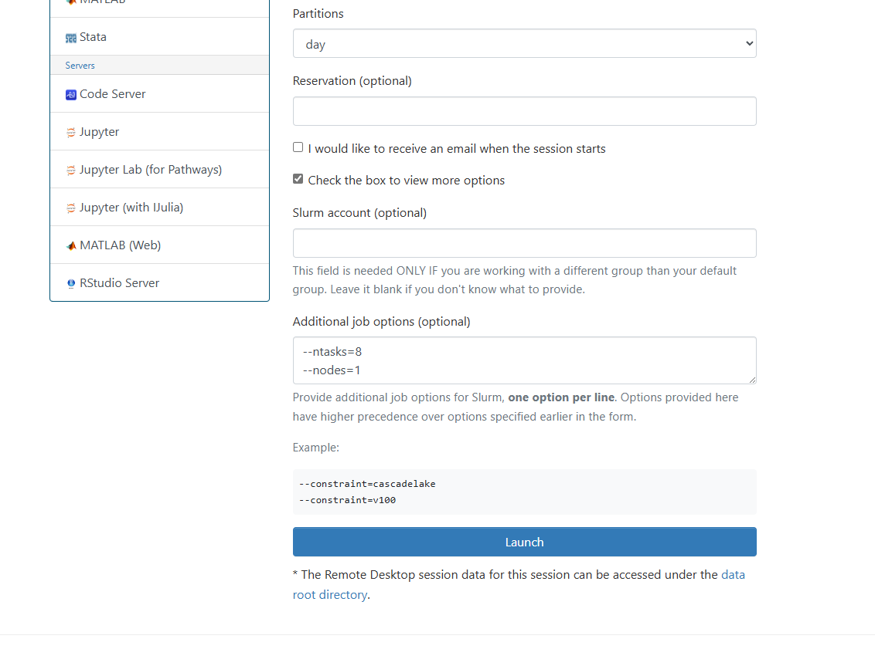

Slide 6
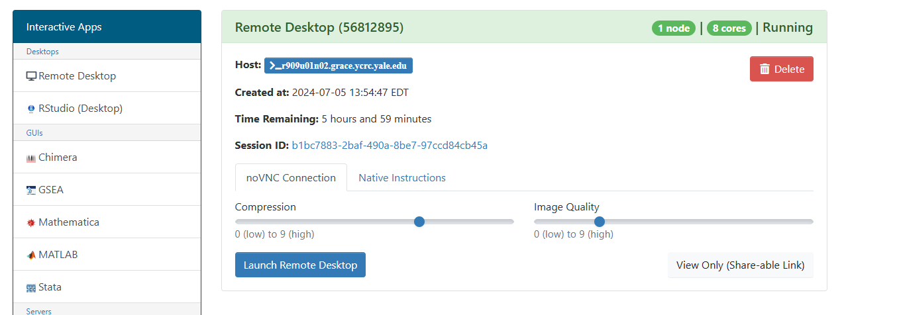

Slide 7
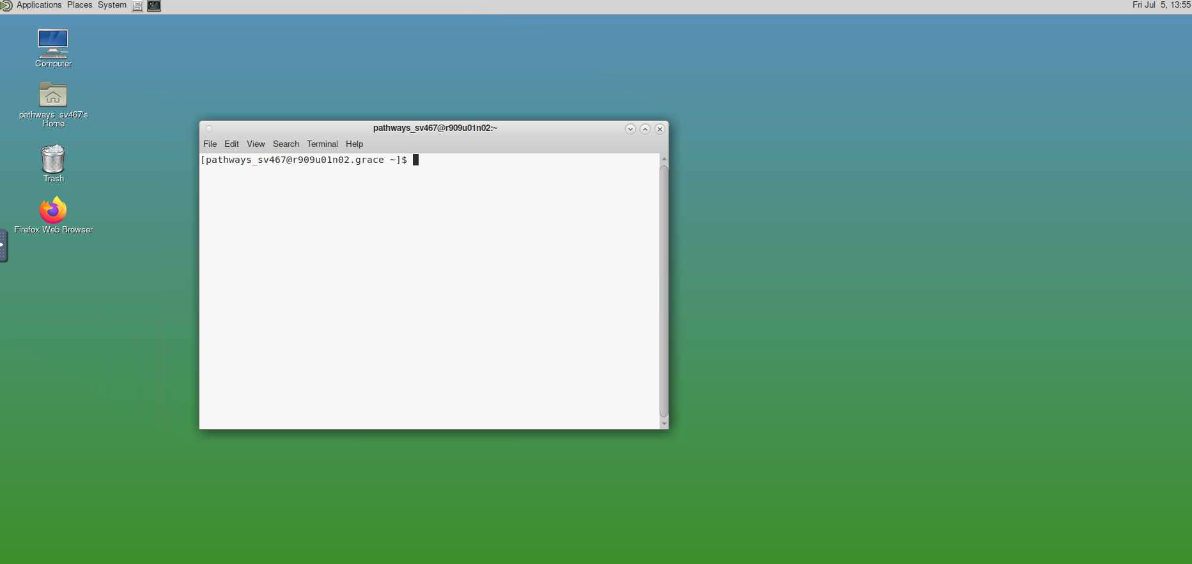

Slide 8
ACCESS TO TUTORIALS
Run: git clone https://github.com/krishnaa423/parallel_tutorial.git
cd parallel_tutorial
source ./setup_script.sh
jupyter lab
----
Then click Tutorial.ipynb
Notes:
Some historical figures

Slide 9
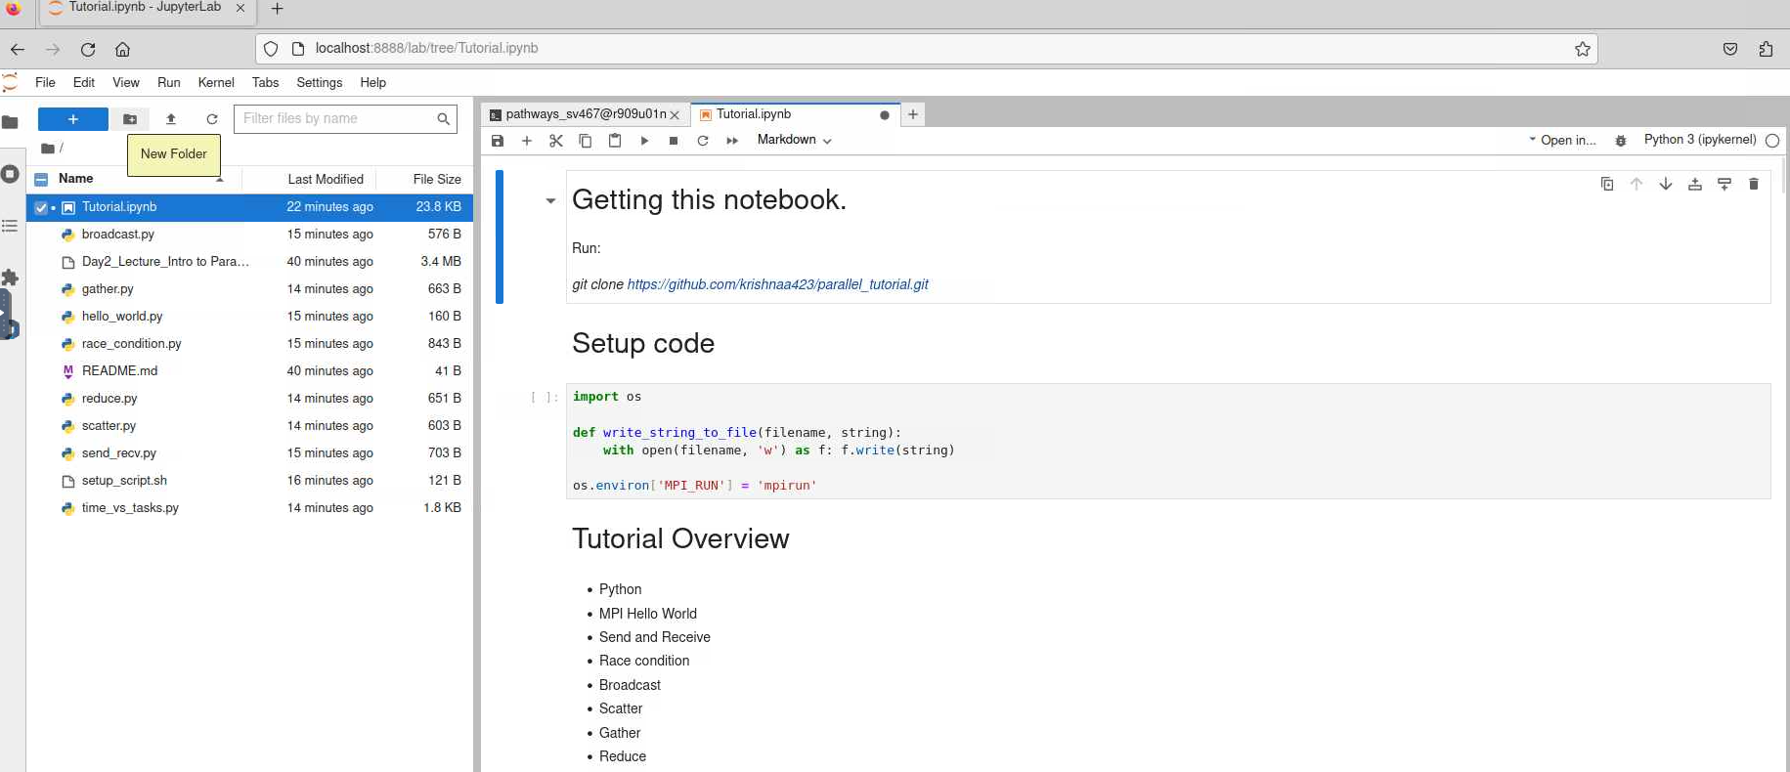
Notes:
Some historical figures

Slide 10
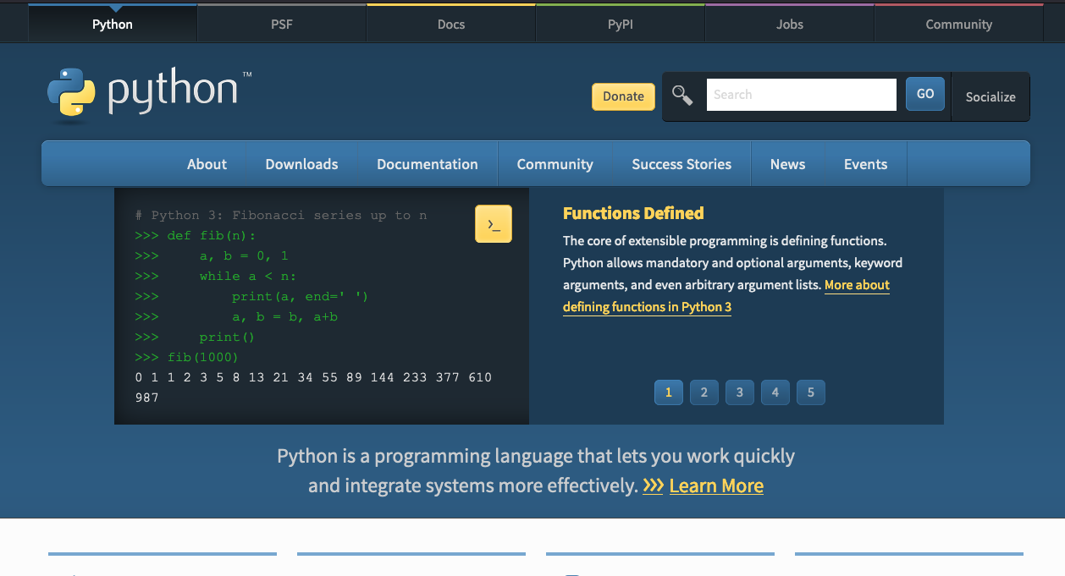
PYTHON
Scripting language
Object-oriented
Easy to read, friendly design
[Terminal] python
>>> a = 2
>>> b = 3
>>> c = a + b
>>> c
5
We can also write the above code in a file sum.py
then run it as
[Terminal] python sum.py
Notes:
Some historical figures

Slide 11
EXAMPLE 1 (PYTHON)
Write the code in a file sum.py
a = 2
b = 3
c = a + b
print(c)
print("The sum is", c)
numpy is a useful module in Python for numbers
import numpy as np
np.a = 2
np.b = 3
np.c = np.a + np.b
print(np.c)
Notes:
Some historical figures

Slide 12
EXAMPLE 2 (NUMPY ADDITION)
Array is a list of data, represented in [], so a = [1 , 2, 3] is an array of size 3
Its elements are a[0], a[1], a[2]
numpy module can be used to create an array -> numpy provides functions
np.arange(3.0) [0, 1.0, 2.0]
directly define the array
2. np.a = np.array([3, 6, 3])
3. np.b = np.array([5, 5, 4])
Now these two arrays can be summed up
np.c = np.a + np.b
print(np.c)
>>[8, 11, 7]
Notes:
Some historical figures

Slide 13
SERIAL COMPUTING
Uses one process to do all the work
Heavy computations will be slow
What if we could do the work in parallel?
We could save time and money
We could work on more complex problems (climate change, energy, big data)
Start
Do All the work!
Notes:
Some historical figures

Slide 14
DIVIDE AND CONQUER
Divide the problem into smaller pieces - subtasks
Different processors
Activity: Breakout rooms 2 students each (grab a pen and a sheet of paper)
Isn’t Parallel computing fun?
Problem
Subtask1
Subtask2
Subtask3
Notes:
Sometimes some calculations we do can take over a moth on regular serial computing

Slide 15
DIVIDE AND CONQUER
Divide the problem into smaller pieces - subtasks
Different processors
Problem
Subtask1
Subtask2
Subtask3
Subtask4
Subtask5
Subtask6
Notes:
Some historical figures

Slide 16
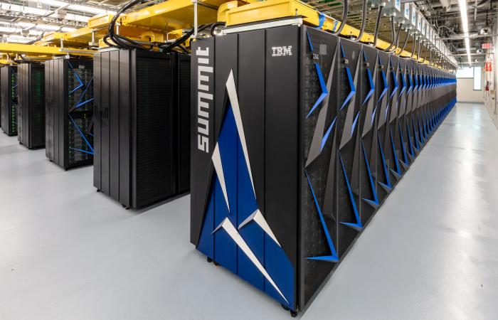
HEAD NODE & COMPUTE NODES
Summit – ORNL, Tennessee
User communicates to the “Head Node”
“Head Node” instructs the ”Compute Nodes”
to carry out the job.
Head Node
Compute node1
Compute node2
Compute node3
Compute node4
Compute node5
compute node6
Notes:
Some historical figures

Slide 17
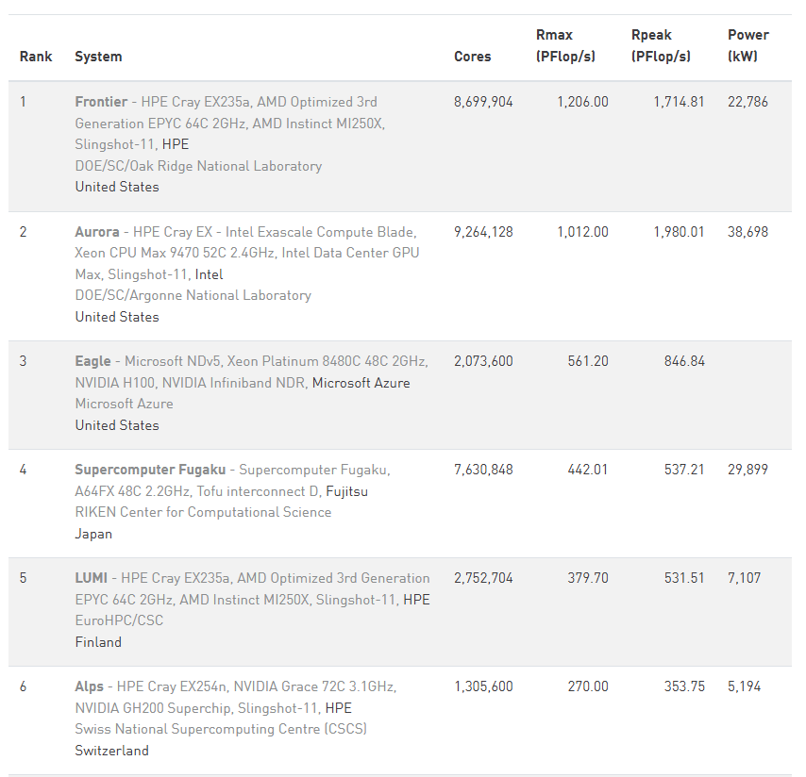

FASTEST SUPERCOMPUTERS
www.top500.org lists the fastest machines
Frontier at Oak Ridge national lab
in Tennessee
Frontier
(https://www.olcf.ornl.gov/frontier/ )
Notes:
Some historical figures

Slide 18
SHARED MEMORY SYSTEMS
CPU
Entire memory shared between all CPUs here
CPUs perform their subtasks individually
Think of 4 members making a dish for a party!
Thanksgiving turkey?
Memory
CPU
CPU
CPU
Notes:
Some historical figures

Slide 19
DISTRIBUTED MEMORY SYSTEMS
CPU
Memory
CPUs have different local memory
CPUs perform their subtasks without any interference
Communication network required to connect
inter-process memory
Example: musicians (from our workshop) performing together
Most modern computing systems use a hybrid shared-distributed
memory
Memory
CPU
Network
Memory CPU
Memory
CPU
Notes:
Some historical figures

Slide 20
HOW TO USE PARALLEL MACHINES
CPU
Memory
Message Passing Interface (MPI) is a commonly used system
Data moved from one part to another using
cooperation between CPUs
For our workshop:
Python programing language
mpi4py python module
How to run in parallel:
serial:
python program.py
On n=6 cores,
mpirun –n 6 python program.py
MPI
MPI
MPI
Memory
CPU
Network
Memory CPU
MPI
Memory
CPU
Notes:
Zoom poll: which is a language

Slide 21
EXAMPLE: PRINT “HELLO”
hello.py
Code snippet:
from mpi4py import MPI
comm = MPI.COMM_WORLD # comm is the MPI object we will use
size = comm.Get_size() # how many processes (1 on each core)
rank = comm.Get_rank() # rank of processor (ID) 0 is head processor
print("Hello world from rank", str(rank), "of", str(size))
mpirun –n 4 python hello_world.py
Hello world from rank 0 of 4
Hello world from rank 1 of 4
Hello world from rank 2 of 4
Hello world from rank 3 of 4
Notes:
Some historical figures

Slide 22
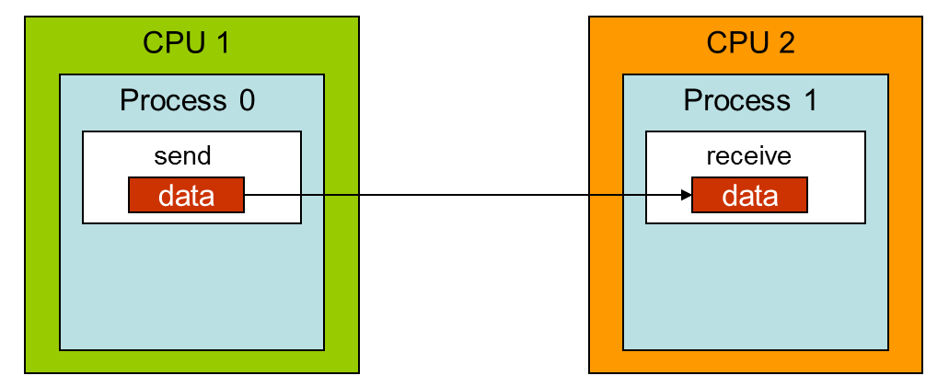
SEND/RECEIVE
Send data from one node to another.
Code snippet:
if rank == 0:
a = np.arange(4)
else:
a = np.zeros(4)
if rank == 0:
comm.Send(a, dest=1, tag=10)
else:
comm.Recv(a, source=0, tag=10)
print(‘After send and receive. Rank: {mpi_rank}, a: {a}')
mpirun –n 4 python send_recv.py
Before send and receive. Rank: 1, a: [0. 0. 0. 0.]
Before send and receive. Rank: 2, a: [0. 0. 0. 0.]
Before send and receive. Rank: 3, a: [0. 0. 0. 0.]
Before send and receive. Rank: 0, a: [0. 1. 2. 3.]
After send and receive. Rank: 0, a: [0. 1. 2. 3.]
After send and receive. Rank: 1, a: [0. 1. 2. 3.]
After send and receive. Rank: 2, a: [0. 0. 0. 0.]
After send and receive. Rank: 3, a: [0. 0. 0. 0.]
Notes:
Some historical figures

Slide 23
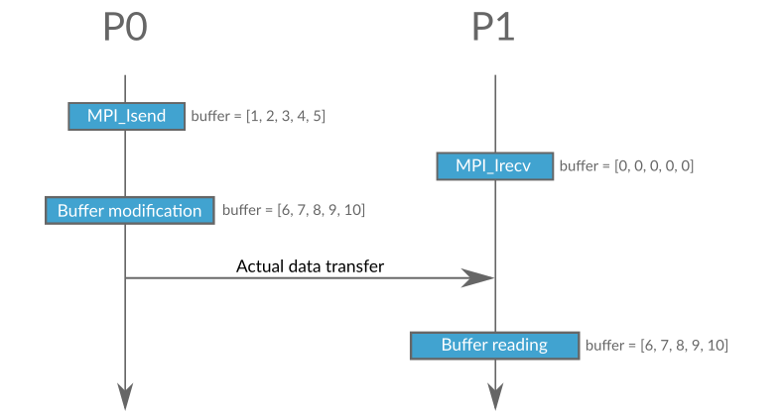
Race Conditions
Need to wait for send/receive to complete.
mpirun –n 2 python race_condition.py
Before send and receive. Rank: 0, a: [0. 1. 2. 3.]
Before send and receive. Rank: 1, a: [0. 0. 0. 0.]
After send and receive. Rank: 1, a: [0. 0. 0. 0.]
After send and receive. Rank: 0, a: [0. 1. 2. 3.]
After send and receive and waiting. Rank: 0, a: [0. 1. 2. 3.] After send and receive and waiting. Rank: 1, a: [0. 1. 2. 3.]
Notes:
Some historical figures

Slide 24
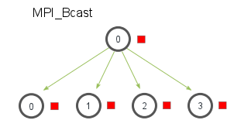
BROADCAST
broadcast data to all cores
Code snippet:
if rank == 0:
data = np.arange(4.0)
else:
data = None
comm.Bcast(a, root=0)
if rank == 0:
print(‘After broadcast. Rank: {mpi_rank}, a: {a}’)
mpirun –n 4 python broadcast.py
Before broadcast. Rank: 0, a: [0. 1. 2. 3.]
Before broadcast. Rank: 1, a: [0. 0. 0. 0.]
Before broadcast. Rank: 2, a: [0. 0. 0. 0.]
Before broadcast. Rank: 3, a: [0. 0. 0. 0.]
After broadcast. Rank: 0, a: [0. 1. 2. 3.]
After broadcast. Rank: 1, a: [0. 1. 2. 3.]
After broadcast. Rank: 2, a: [0. 1. 2. 3.]
After broadcast. Rank: 3, a: [0. 1. 2. 3.]
Notes:
Some historical figures

Slide 25
ZOOM POLL
Amber alert for thunderstorms is an example of broadcast?
True
False
If hurricane Elsa reaches Miami, FL in the morning and New Haven in the afternoon, should we send same messages by broadcasting to the two states?
We could, but separate alerts might be better -> scatter message to different states
Weather Department
Broadcast
County1
County2
County3
Notes:
Some historical figures

Slide 26
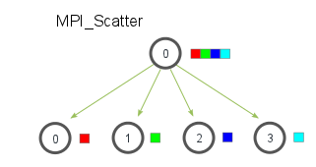
SCATTER
Scatter data to various tasks
Code snippet:
if rank == 0:
initial_data = np.arange(4.0)
else:
initial_data = None
comm.Scatterv(initial_data, scattered_data, root=0)
if rank == 0:
print(‘After scatter. Rank: {mpi_rank}, a: {initial_data}, b: {scattered_data}')
mpirun –n 4 python scatter.py
Before scatter. Rank: 1, a: [0. 0. 0. 0. 0. 0. 0. 0.], b: [0. 0.]
Before scatter. Rank: 2, a: [0. 0. 0. 0. 0. 0. 0. 0.], b: [0. 0.]
Before scatter. Rank: 3, a: [0. 0. 0. 0. 0. 0. 0. 0.], b: [0. 0.]
Before scatter. Rank: 0, a: [0. 1. 2. 3. 4. 5. 6. 7.], b: [0. 0.]
After scatter. Rank: 1, a: [0. 0. 0. 0. 0. 0. 0. 0.], b: [2. 3.]
After scatter. Rank: 3, a: [0. 0. 0. 0. 0. 0. 0. 0.], b: [6. 7.]
After scatter. Rank: 0, a: [0. 1. 2. 3. 4. 5. 6. 7.], b: [0. 1.]
After scatter. Rank: 2, a: [0. 0. 0. 0. 0. 0. 0. 0.], b: [4. 5.]
Notes:
Some historical figures

Slide 27
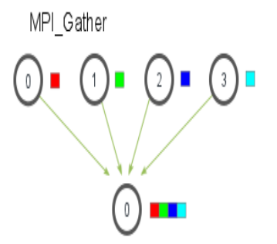
GATHER
Gather data from various tasks
Code snippet:
# Previous scattered data.
comm.Gatherv(initial_data, gathered_data, root=0)
if rank == 0:
print(‘After gather. Rank: {mpi_rank}, b: {initial_data}, c: {gathered_data}')
mpirun –n 4 python gather.py
Before gather. Rank: 0, b: [0. 1.], c: [0. 0. 0. 0. 0. 0. 0. 0.] Before gather. Rank: 1, b: [2. 3.], c: [0. 0. 0. 0. 0. 0. 0. 0.] Before gather. Rank: 2, b: [4. 5.], c: [0. 0. 0. 0. 0. 0. 0. 0.] Before gather. Rank: 3, b: [6. 7.], c: [0. 0. 0. 0. 0. 0. 0. 0.]
After gather. Rank: 1, b: [2. 3.], c: [0. 0. 0. 0. 0. 0. 0. 0.] After gather. Rank: 2, b: [4. 5.], c: [0. 0. 0. 0. 0. 0. 0. 0.] After gather. Rank: 3, b: [6. 7.], c: [0. 0. 0. 0. 0. 0. 0. 0.] After gather. Rank: 0, b: [0. 1.], c: [0. 1. 2. 3. 4. 5. 6. 7.]
Notes:
Some historical figures

Slide 28
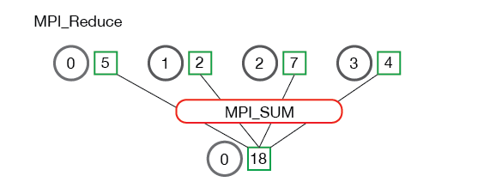
REDUCE
Reduce data to root process
Code snippet:
# Previous scattered data.
comm.Reduce(initial_data, reduced_data, root=0)
if rank == 0:
print(‘After reduce. Rank: {mpi_rank}, b: {initial_data}, c: {reduce_data}')
mpirun –n 4 python reduce.py
Before reduce. Rank: 0, b: [0. 1. 0. 0. 0. 0. 0. 0.], c: [0. 0. 0. 0. 0. 0. 0. 0.] Before reduce. Rank: 2, b: [4. 5. 0. 0. 0. 0. 0. 0.], c: [0. 0. 0. 0. 0. 0. 0. 0.] Before reduce. Rank: 1, b: [2. 3. 0. 0. 0. 0. 0. 0.], c: [0. 0. 0. 0. 0. 0. 0. 0.] Before reduce. Rank: 3, b: [6. 7. 0. 0. 0. 0. 0. 0.], c: [0. 0. 0. 0. 0. 0. 0. 0.]
After reduce. Rank: 1, b: [2. 3. 0. 0. 0. 0. 0. 0.], c: [0. 0. 0. 0. 0. 0. 0. 0.]
After reduce. Rank: 3, b: [6. 7. 0. 0. 0. 0. 0. 0.], c: [0. 0. 0. 0. 0. 0. 0. 0.]
After reduce. Rank: 0, b: [0. 1. 0. 0. 0. 0. 0. 0.], c: [12. 16. 0. 0. 0. 0. 0. 0.] After reduce. Rank: 2, b: [4. 5. 0. 0. 0. 0. 0. 0.], c: [0. 0. 0. 0. 0. 0. 0. 0.]
Notes:
Some historical figures

Slide 29
PARALLEL SUM
Scatter, reduce, and sum.
Code snippet:
# Previous scattered data.
comm.Reduce(scattered_data, reduced_data, root=0)
sum = np.sum(reduced_data)
mpirun –n 4 python time_vs_tasks.py
ntask: 1, time: 0.021273016000009193, sum: 49999995000000.0
ntask: 2, time: 0.01688439699999833, sum: 49999995000000.0
ntask: 3, time: 0.016065210000007824, sum: 49999995000000.0
ntask: 4, time: 0.01636834999999337, sum: 49999995000000.0
ntask: 5, time: 0.01778990100000044, sum: 49999995000000.0
ntask: 6, time: 0.01922156199999847, sum: 49999995000000.0
ntask: 7, time: 0.018235153999995646, sum: 49999995000000.0
ntask: 8, time: 0.017280360000000883, sum: 49999995000000.0
Notes:
Some historical figures

Slide 30
KEY POINTS
python language is useful for serial and parallel computing
Supercomputers have a hybrid of shared & distributed memory systems
For parallel computing, we use mpi4py module
basic communication techniques
broadcast – send the entire data to all processors
Send/receive – Send from one process to another.
scatter – send different data to different processors
gather – gather the data from all processors and do some operation
Reduce – Perform a reduction operation and get the result to a since process.

Slide 31
RESOURCES
https://hpc.llnl.gov/training/tutorials/introduction-parallel-computing-tutorial
https://towardsdatascience.com/parallel-programming-in-python-with-message-passing-interface-mpi4py-551e3f198053
https://www.kth.se/blogs/pdc/2019/08/parallel-programming-in-python-mpi4py-part-1/
Notes:
Some historical figures

